Slide 1
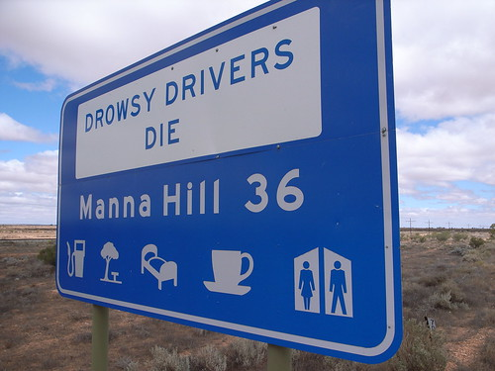
DRIVER
DROWSINESS
DETECTION
Neha BS(4MT20AI021)
Ankith Shetty (4MT20AI004)
Sanjay S M(4MT20AI038)

Slide 2
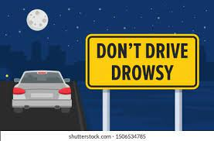
INTRODUCTION
Drowsy driving is a serious problem that affects millions of people every year.
Whether it's due to a long day at work, a sleepless night, or a medical condition, drowsiness can impair drivers and increase the risk of accidents on the road.
Fortunately, advancements in technology have led to the development of drowsiness detection systems, which can help prevent accidents before they occur.
In this presentation, we will discuss the importance of drowsiness detection systems and their potential impact on road safety.
We will explore the dangers of drowsy driving, the technology behind these systems, and the benefits they offer.
By the end of this presentation, you will understand why drowsiness detection systems are so critical and how they can save lives.

Slide 3
Problem statement
The objective of this project is to develop a driver drowsiness detection system using image processing techniques. The system should be able to analyze facial features, such as eyes, nose, and mouth, in real-time images or videos captured from a camera. By monitoring the driver's eye activity and applying fuzzy logic analysis, the system should be able to determine if the driver is drowsy or not. If drowsiness is detected, appropriate warning signals, such as visual alerts and auditory alarms, should be triggered to alert the driver and prevent potential accidents.

Slide 4
OBJECTIVE
The objective of this project is to develop a driver drowsiness detection system using computer vision techniques. It aims to detect faces, eyes, nose, and mouth in real-time images. By analyzing the eye regions and applying fuzzy logic, the system determines if the driver is drowsy. If drowsiness is detected, appropriate warnings and alerts are triggered to ensure driver safety.

Slide 5
OVERVIEW
Face Detection: The system uses a cascade object detector to locate and identify faces in the input image. If no faces are detected, a warning message is displayed.
Eye Pair Detection: A specialized eye pair cascade object detector is applied to the face region to locate the eyes. If no eyes are detected, a warning message is displayed.
Nose Detection: Another cascade object detector is employed to detect the presence of a nose in the face region. If no nose is detected, a warning message is displayed.
Mouth Detection: A cascade object detector is used to locate the mouth within the face region. If no mouth is detected, a warning message is displayed.

Slide 6
OVERVIEW
Eye Analysis: The system extracts the left and right eye regions from the eye pair. Fuzzy logic analysis is applied to determine if the eyes are closed or open. If drowsiness is detected based on the eye analysis, a warning message is displayed.
Visual and Auditory Alerts: If the driver is deemed drowsy, a warning message with a red color scheme is shown. Additionally, the system triggers a blinking effect on the warning message to attract the driver's attention. An audio alarm is played simultaneously to further alert the driver.
Safe State: If no signs of drowsiness are detected, a safe state message is displayed.
By combining facial feature detection, eye analysis, and warning alerts, the system aims to enhance driver safety by detecting and preventing drowsiness-related accidents.

Slide 7
IMPORTANCE
1.Prevention of Accidents
2.Preservation of Lives
3.Road Safety Improvement
4.Cost Reduction
5.Technology Advancement

Slide 8
APPLICATION
1. Automotive Industry
2. Transportation and Logistics
3. Public Transport
4. Commercial Driver Safety
5. Personal Driver Safety
6. Insurance Industry
7. Healthcare Monitoring
8. Human-Computer Interaction
9. Smart Home Technology

Slide 9
REQUIREMENTS
HARDWARE REQUIREMENTS
1.Processor: Intel i3/i5,1.8GHz machine or above
2.Main memory: 4GB RAM or more
3.Hard disk drive: 1TB
SOFTWARE REQUIREMENTS
1.Operating System: Windows 7 and higher
2.MATLAB
3.MATLAB Image Processing Toolbox
4.Audio playback capabilities
5.Image files

Slide 10
CONCLUSION
In conclusion, the Driver Drowsiness Detection project successfully demonstrated the effectiveness of using fuzzy logic and computer vision techniques to detect driver drowsiness based on eye behavior. By analyzing captured images or video frames, the system detected faces, tracked eye movements, and provided timely alerts when signs of drowsiness were detected. The project showcased the potential of technology in enhancing driver safety by mitigating the risks associated with drowsy driving. With further advancements and integration of machine learning and real-time monitoring, this system holds promise for wider implementation in vehicles, contributing to a safer and more vigilant driving experience.

Slide 11
THANK
YOU

